Slide 2

Natural Language Processing
Middle Project: Song Classification using BERT
Instructor: Dr. Le Thanh Huong
Students: Group 24
Le Hoang Long - 20232099M - 23B-IT-KHDL-E
Lê Thành Vinh - 20200668
Lưu Anh Đức - 20204875
Phùng Hà Nguyên - 20190087

Slide 3
CONTENTS
Introduction
Problem Definition and Algorithm
Evaluation
Conclusion

Slide 4
INTRODUCTION
Song genre classification is an interesting and challenging task in the field of natural language processing (NLP).
It involves automatically assigning a genre label to a given song based on its audio features or lyrics.
Traditionally, experts manually categorized songs, but with the advent of machine learning and data science, we can now automate this process using algorithms
BERT (Bidirectional Encoder Representations from Transformers) has become a powerful tool for text classification tasks in natural language processing (NLP).

Slide 5
PROBLEM DEFINITION AND ALGORITHM
Song genre classification is an interesting and challenging task in the field of natural language processing (NLP).
It involves automatically assigning a genre label to a given song based on its audio features or lyrics.
Traditionally, experts manually categorized songs, but with the advent of machine learning and data science, we can now automate this process using algorithms
BERT (Bidirectional Encoder Representations from Transformers) has become a powerful tool for text classification tasks in natural language processing (NLP).

Slide 6
PROBLEM DEFINITION AND ALGORITHM
Project overview:
The goal is to categorize lyrics into specific genres (e.g., disco, hip-hop, rock) based on their content.
Applying transfer learning method to leverage knowledge learned from one task to improve performance on another related task.
BERT overview
It captures bidirectional context by considering both left and right context for each token in a sentence.
It captures contextual information effectively.
Fine-tuning BERT requires less labeled data compared to training from scratch. It provides better performance and faster convergence.

Slide 7
PROBLEM DEFINITION AND ALGORITHM
Dataset Selection
The data is composed of four sources. The initial data was forwarded from Sparktech's 2018 Textract Hackathon. This was enhanced with data from other three kaggle datasets: 150K Lyrics Labeled with Spotify Valence, dataset lyrics musics and AZLyrics song lyrics.
Dataset link: https://www.kaggle.com/datasets/mateibejan/multilingual-lyrics-for-genre-classification
Approaches
Applying a pre-trained BERT model on the dataset.
Adding a classification layer on top of BERT.
Training the entire model on labeled data.

Slide 8
PROBLEM DEFINITION AND ALGORITHM
Data Preprocessing
Challenges
Imbalanced data: the representation of different genres is not balanced
Lyric length: BERT has a maximum token limit
Solutions
Removing all non english song
Handling imbalanced class distributions by choosing an equal number of songs per class
Chunking song lyrics

Slide 9
PROBLEM DEFINITION AND ALGORITHM
Solution
Link: https://www.kaggle.com/code/lehoanglonglong/hust-song-classification-using-bert
Source code:

Slide 10
import os
import torch
from torch import nn
from torch.utils.data import DataLoader, Dataset
from transformers import BertTokenizer, BertModel, AdamW, get_linear_schedule_with_warmup
from sklearn.model_selection import train_test_split
from sklearn.metrics import accuracy_score, classification_report
import pandas as pd

Slide 11
def load_song_data(data_file, bert_model_name, max_length):
df = pd.read_csv(data_file)
tokenizer = BertTokenizer.from_pretrained(bert_model_name)
df['encoding'] = df.apply(lambda x: tokenizer(x['S_Lyric'], return_tensors='pt', max_length=max_length, padding='max_length', truncation=True) , axis=1)
encodings = df['encoding'].tolist()
#texts = df['S_Lyric'].tolist()
labels = [int(v) for v in df['Genre_Index'].tolist()]
ids_genres = df[['Genre_Index', 'Genre']].drop_duplicates()
ids_genres = ids_genres.set_index('Genre_Index')
return encodings, labels, ids_genres
#return texts, labels, ids_genres

Slide 12
class TextClassificationDataset(Dataset):
def __init__(self, texts, labels, tokenizer, max_length):
self.texts = texts
self.labels = labels
self.tokenizer = tokenizer
self.max_length = max_length
pass
def __len__(self):
return len(self.texts)
def __getitem__(self, idx):
encoding = self.texts[idx]
label = self.labels[idx]
return {'input_ids': encoding['input_ids'].flatten(), 'attention_mask': encoding['attention_mask'].flatten(), 'label': torch.tensor(label)}

Slide 13
class BERTClassifier(nn.Module):
def __init__(self, bert_model_name, num_classes):
super(BERTClassifier, self).__init__()
self.bert = BertModel.from_pretrained(bert_model_name)
self.dropout = nn.Dropout(0.1)
self.fc = nn.Linear(self.bert.config.hidden_size, num_classes)
def forward(self, input_ids, attention_mask):
outputs = self.bert(input_ids=input_ids, attention_mask=attention_mask)
pooled_output = outputs.pooler_output
x = self.dropout(pooled_output)
logits = self.fc(x)
return logits

Slide 14
def train(model, data_loader, optimizer, scheduler, device):
model.train()
for batch in data_loader:
optimizer.zero_grad()
input_ids = batch['input_ids'].to(device)
attention_mask = batch['attention_mask'].to(device)
labels = batch['label'].to(device)
outputs = model(input_ids=input_ids, attention_mask=attention_mask)
loss = nn.CrossEntropyLoss()(outputs, labels)
loss.backward()
optimizer.step()
scheduler.step()

Slide 15
def evaluate(model, data_loader, device):
model.eval()
predictions = []
actual_labels = []
with torch.no_grad():
for batch in data_loader:
input_ids = batch['input_ids'].to(device)
attention_mask = batch['attention_mask'].to(device)
labels = batch['label'].to(device)
outputs = model(input_ids=input_ids, attention_mask=attention_mask)
_, preds = torch.max(outputs, dim=1)
predictions.extend(preds.cpu().tolist())
actual_labels.extend(labels.cpu().tolist())
return accuracy_score(actual_labels, predictions), classification_report(actual_labels, predictions)

Slide 16
# Set up parameters
bert_model_name = 'bert-base-uncased'
max_length = 128
batch_size = 16
num_epochs = 10
learning_rate = 2e-5
data_file = "/kaggle/input/smallsongs2/l_df.csv"
texts, labels, ids_genres = load_song_data(data_file, bert_model_name, max_length)
train_texts, val_texts, train_labels, val_labels = train_test_split(texts, labels, test_size=0.2)

Slide 17
tokenizer = BertTokenizer.from_pretrained(bert_model_name)
train_dataset = TextClassificationDataset(train_texts, train_labels, tokenizer, max_length)
val_dataset = TextClassificationDataset(val_texts, val_labels, tokenizer, max_length)
train_dataloader = DataLoader(train_dataset, batch_size=batch_size, shuffle=True)
val_dataloader = DataLoader(val_dataset, batch_size=batch_size)
num_classes = ids_genres.shape[0]
device = torch.device("cuda" if torch.cuda.is_available() else "cpu")
model = BERTClassifier(bert_model_name, num_classes) #.to(device)
model = torch.nn.DataParallel(model).to(device) #.to(device).to(device)
optimizer = AdamW(model.parameters(), lr=learning_rate)
total_steps = len(train_dataloader) * num_epochs
scheduler = get_linear_schedule_with_warmup(optimizer, num_warmup_steps=0, num_training_steps=total_steps)

Slide 18
for epoch in range(num_epochs):
print(f"Epoch {epoch + 1}/{num_epochs}")
train(model, train_dataloader, optimizer, scheduler, device)
accuracy, report = evaluate(model, train_dataloader, device)
print(f"Train Accuracy: {accuracy:.4f}")
accuracy, report = evaluate(model, val_dataloader, device)
print(f"Validation Accuracy: {accuracy:.4f}")
torch.save(model.state_dict(), f"version-{epoch}-acc-{accuracy:.4f}.pth")
print(report)

Slide 19
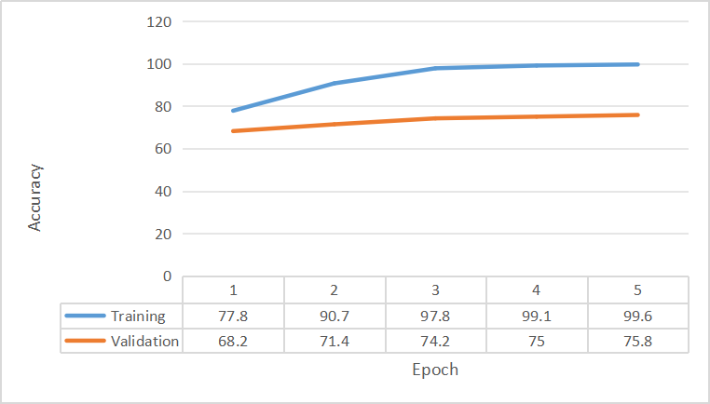
EVALUATION

Slide 20
CONCLUSION
Text classification is a fundamental task in natural language processing (NLP) that involves automatically determining the class or category to which a piece of text belongs.
We applied transformer-based model in the project (BERT) in order to capture rich contextual information, making it effective for downstream tasks.
We could gain a better result with BigBird model but the new model asks for a greater GPU resource which is beyond the current investment.
According to industry standard, a good accuracy is above 70%.

Slide 21
THANK YOU !

